Slide 1
ISO 27001 Auditing Process

Slide 2
Audit
Auditing is defined as the on-site verification activity, such as inspection or examination, of a process or quality system, to ensure compliance to requirements. An audit can apply to an entire organization or might be specific to a function, process, or production step. Some audits have special administrative purposes, such as auditing documents, risk, or performance, or following up on completed corrective actions.
What Are the Types of ISO Audits?
SUPPLIER
Internal Audit (First -party audit)- - An internal ISO audit can be conducted by a designated auditor within your company
External Audit (Second -party audit)- - An external audit is similar to an internal audit; the main difference is that the auditor will come from a third-party source outside of the organization.
External Audit (third-party audit)- The final external audit is the certification audit. This is from a registrar.
Self Audit = FIRST PARTY AUDIT
Customer Audit = SECOND PARTY AUDIT
ORGANIZATION
Audit done by
Any other Party
Other than
Customer / Self
=
Self Audit = FIRST PARTY AUDIT
Customer Audit = SECOND PARTY AUDIT
CUSTOMER
Self Audit = FIRST PARTY AUDIT

Slide 3
The importance of auditing ISO 27001 controls
Internal audits are essential, both as part of meeting the requirements of the ISO 27001 standard, as well as to facilitate improvements to your own information security processes. Internal audits are one of the key components for ISO 27001 implementation success, and therefore, it is crucial that they are carried out regularly – and, more importantly – carried out effectively.
ISO 27001:2013 states that the purpose of the internal audit is to check compliance against both “the organization’s own requirements … and the requirements of this International Standard.”
Internal audits identify and rectify any issues before an external certification audit is carried out.
Internal audits identify opportunities for improvement.
Internal audits are important for several other reasons:
Performing regular internal audits provides reassurance to the organization and the certification body that you are continuously reviewing the Information Security Management System (ISMS).
Internal audits serve as a reminder to staff that compliance with requirements is a business priority.

Slide 4
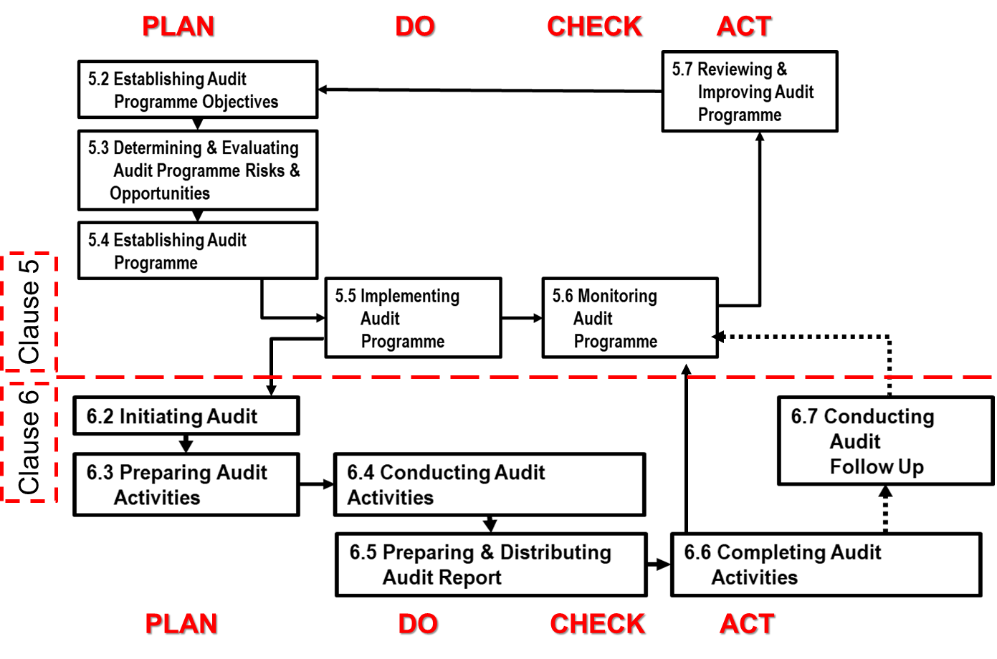
Auditing Life Cycle

Slide 5
Auditing Life Cycle
AUDIT PLANNING
Audit Request
Audit Data Agreement
Audit Assignment
AUDIT PREPARATION
Audit Preparation
Agenda Sent to Auditee
Requirements Request
AUDIT EXECUTION
Audit Execution
Preliminary Report issuance
Draft Audit Report issuance
Final Report Issuance
AUDIT FOLLOW UP
Action Plan sent to audit sponsors
Remediation Plan Periodic update
Bi-annual remediation Plan Follow up
Communication of results Auditee

Slide 6
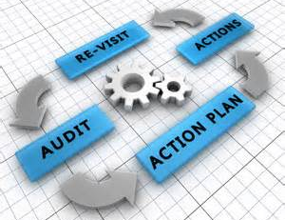

Introduction to System Audit
Sampling Audit
SAMPLING METHODOLOGY
Samples (P.D.P)
Processes (P) + Documents (D) + People (P)
Systematic, independent and documented process for obtaining audit evidence and evaluating it objectively to determine the extent to which the audit criteria are fulfilled
THERE ARE FOUR (4) AUDIT CRITERIA
1> ISMS Standard (ISO 27001:2013)
&
2> Interested Party Requirements
&
3> ISMS Documents
&
4> Legal requirements (Statutes & Regulatory)
Evidences of Audit Finding
Details of the samples of PDP
Process > VAPT Process
Document >VAPT Plan # 4 Issue 1 Dt XX/XX/XX
People > Data Center In-charge & Team
CORRECTIVE
ACTIONS
FACTS OF
NON-CONFORMITY CONFORMITY

Slide 7
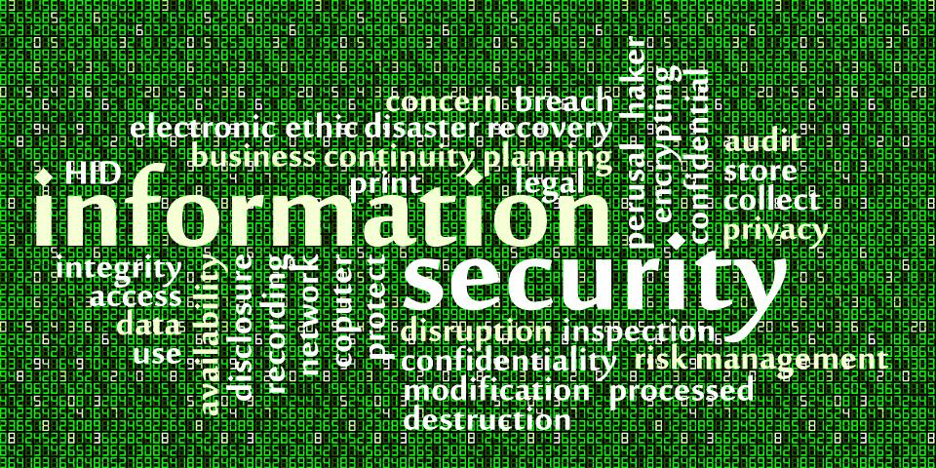
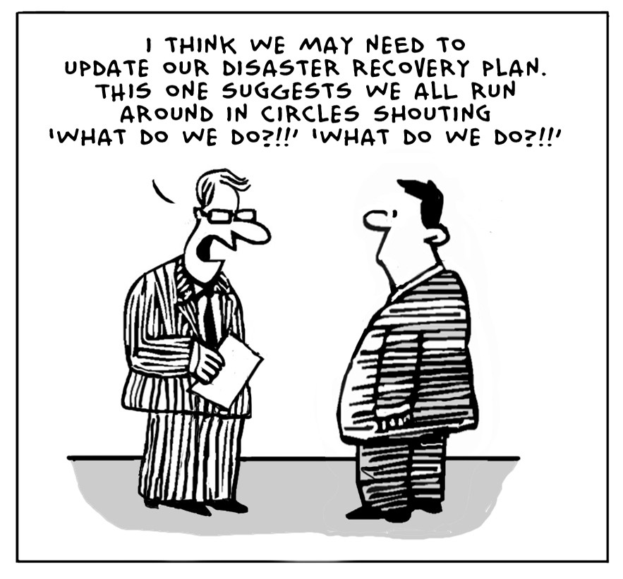

Purpose of System Audit INTENT
The main objective of systems auditing is to validate the integrity of the information and data stored in the databases of the information systems and their processing.
Productive and Team work !
Only on documents !

Slide 8

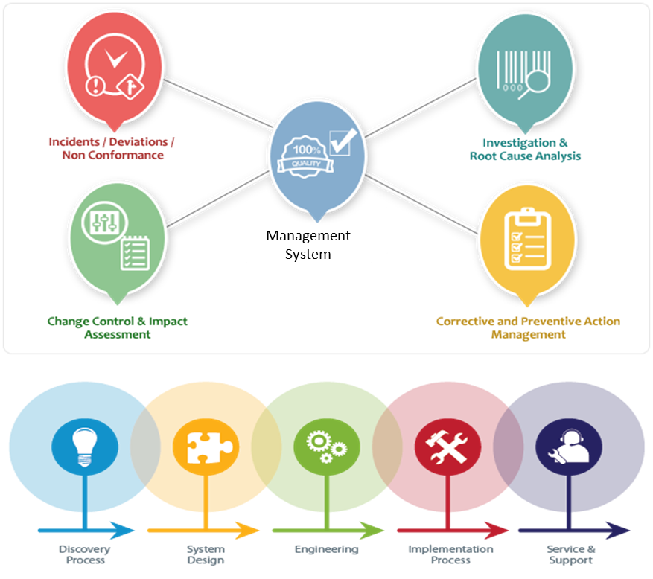
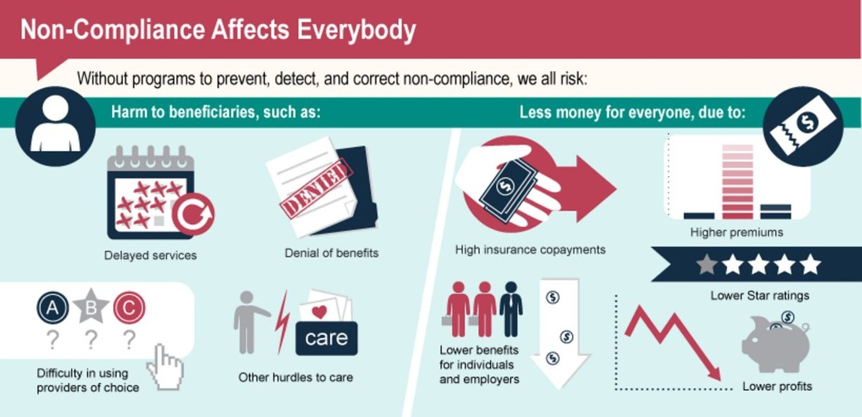
Purpose of System Audit CONTENT
Compliance !
Non-Compliance !

Slide 9
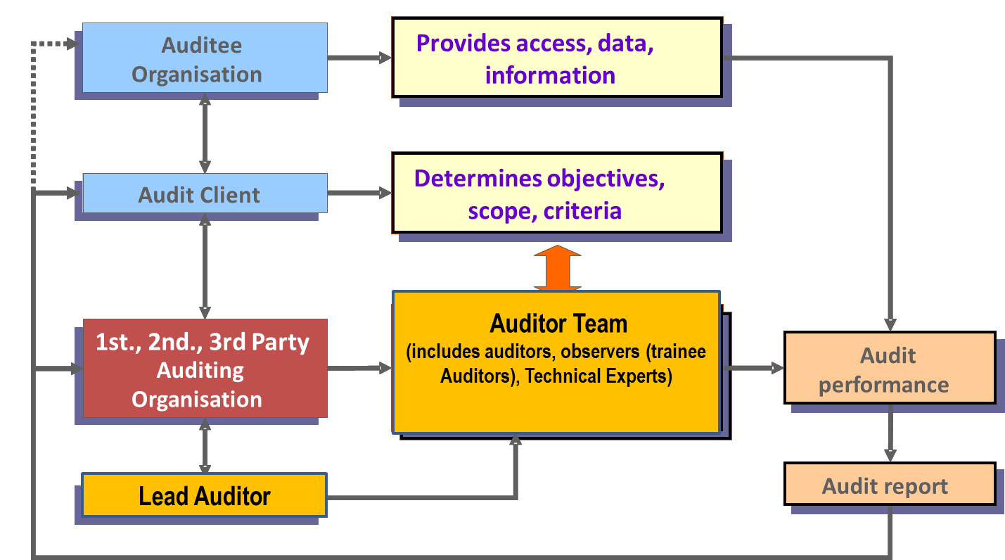
Parties involved in Audit & Roles

Slide 10
Dimensions of Auditing – I, I, E & E
INTENT
Does Top Management & the team intends to accept & implement ISMS and how is this intent communicated?
IMPLEMENTATION
EFFECTIVENESS
& EFFICIENCY
Does the implementation of the ISMS reflect the intent of Top Management & it’s team?
Is the implementation effective & efficient ? (i.e., does it meet the parameters established by the intent are met )

Slide 11
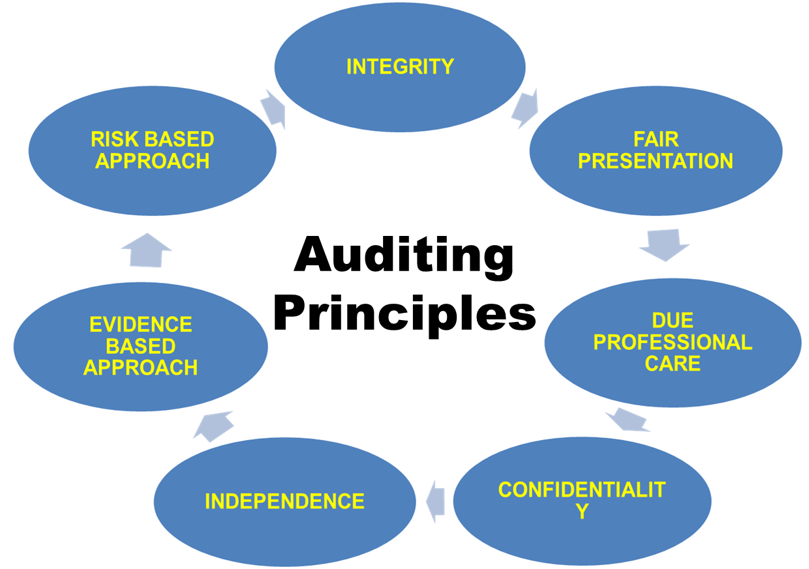
Principles for Performing ISMS Audits

Slide 12
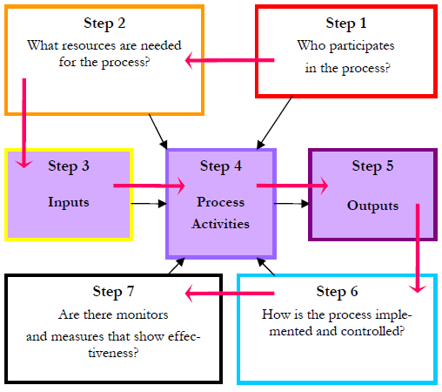
Applying the Process Approach to Auditing
Auditors apply the process approach to auditing to ensure that Organization has…….:
Defined the objectives, inputs, outputs, activities, resources and methods for its processes
Understands the sequence and interaction of its processes
Analyzes, monitors, measures, and improves its processes

Slide 13
Risks in Auditing
The Audit Risk Model
Inherent Risk and Control risk:
Risk of material misstatement
Audit Risk = IR * CR * DR
Detection risk:
Risk that auditor will not detect misstatement
Ineffective audit procedures
Whether the audit procedures were performed with due care
Non sampling risk
Sampling risk

Slide 14
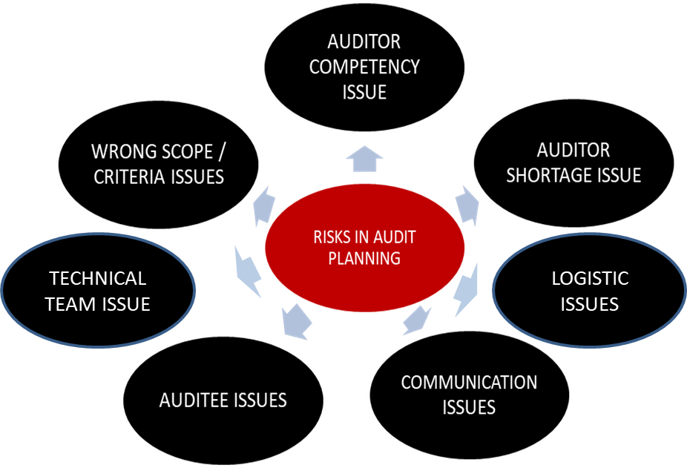
Risks in Audit Programme

Slide 15
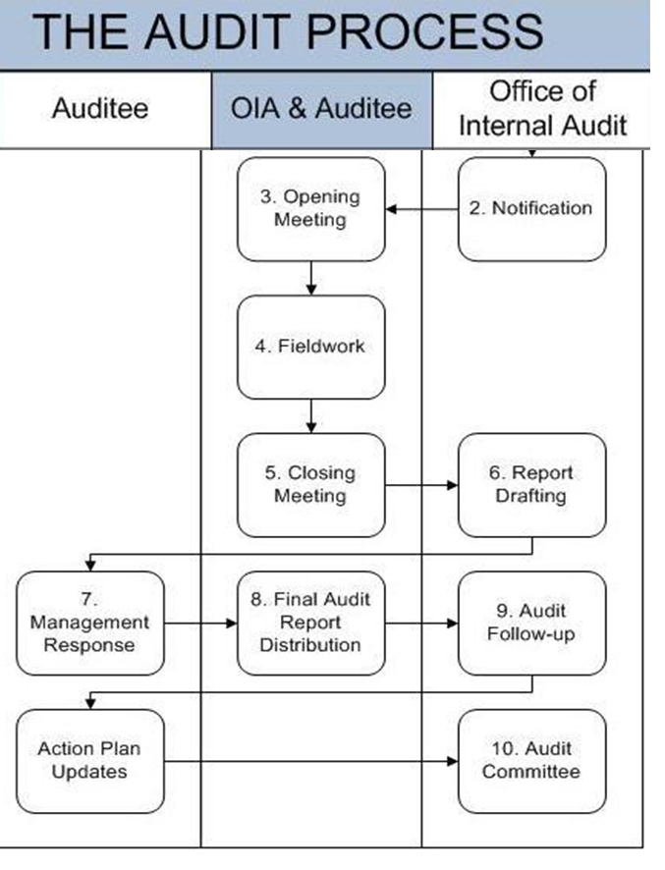
Risks in Audit Execution
Audit Execution Issue
Issues of audit completeness (more/less TIME)
Logistic issues
Audit Execution Issues
Administrative issue during Audit
Issues for audit scope different = Applied vs. Plan
IT system non-availability for online Auditing

Slide 16
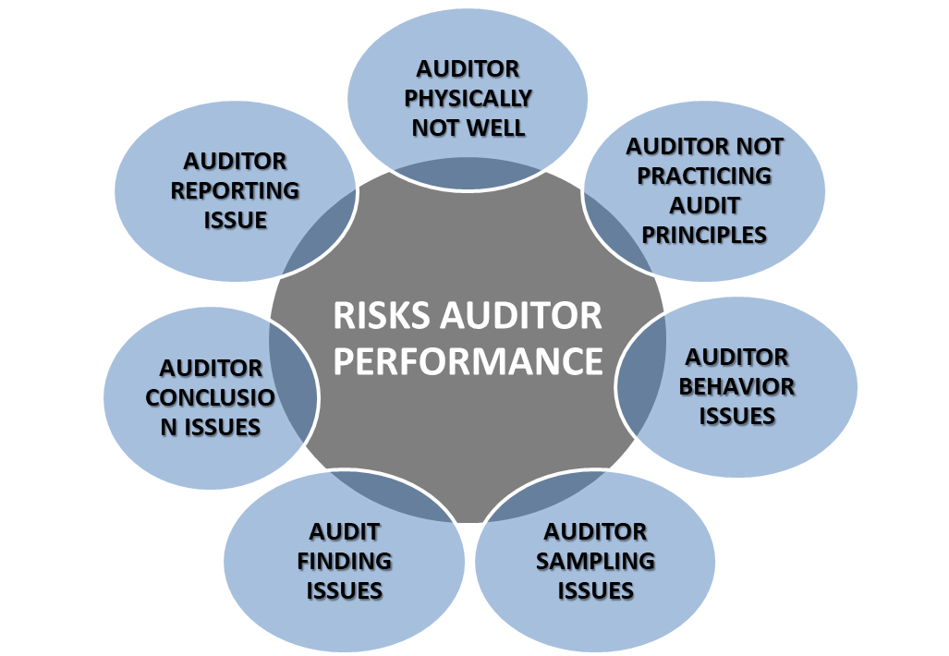

Auditor Performance / Auditor Quality

Slide 17
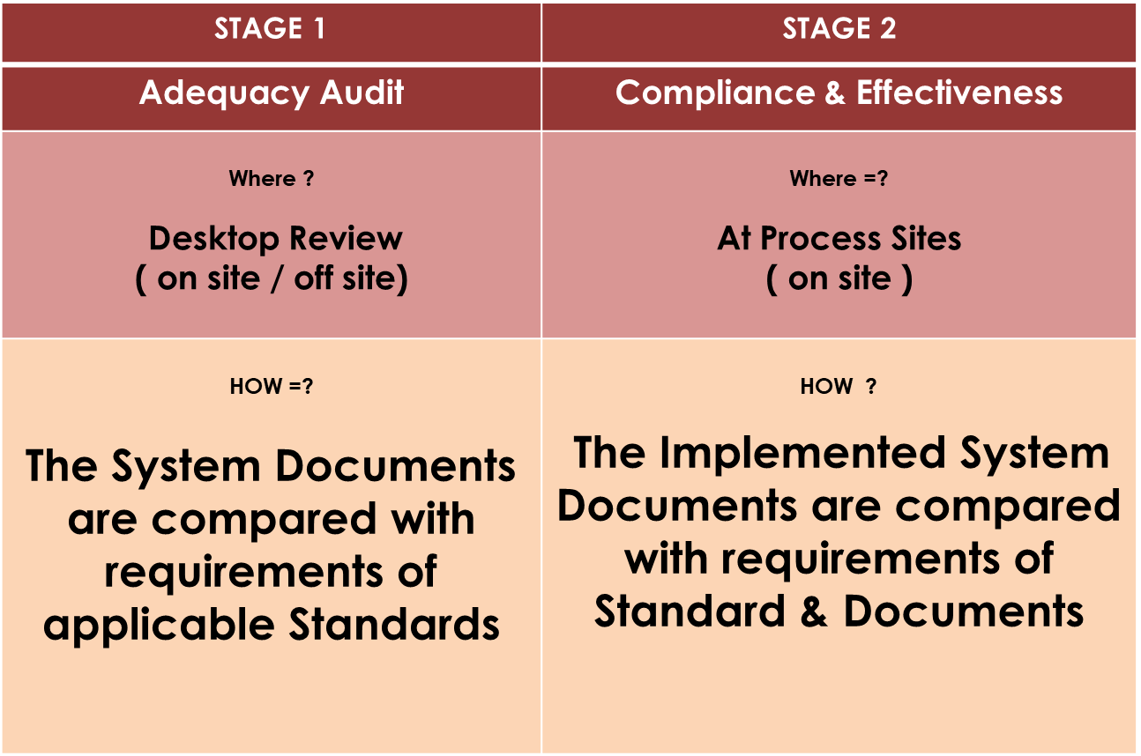
Audit Activities
Initial Certification > Difference between Stage 1 & Stage 2 Audit

Slide 18
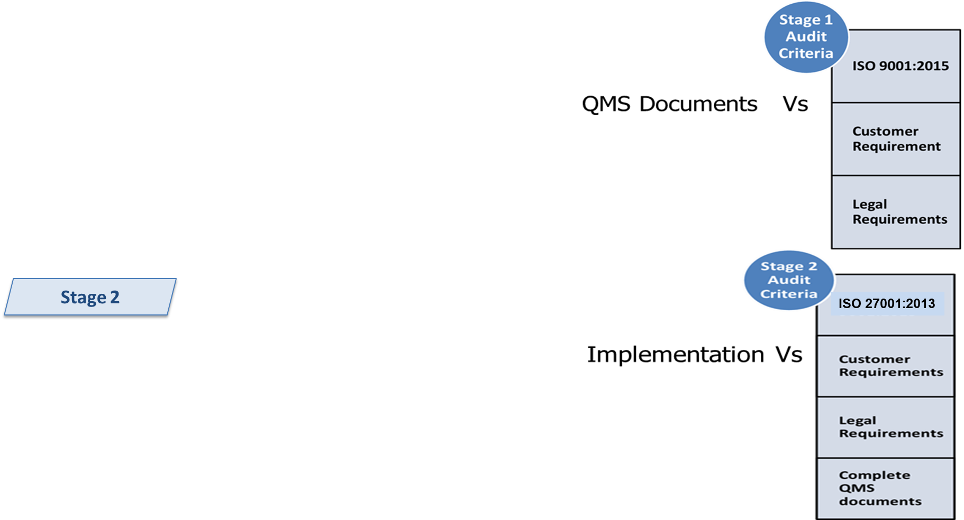

Audit Stages > Logical Sequence of First time Certification
Stage 1
BCMS/
Not Complying ?
Corrective Actions
Recommended for Stage 2
Follow Up Audit
(only Major NC)
No Major NC Complying ?
Corrective Actions
Recommended for CERTIFICATION

Slide 19

Document Review ……..Stage 1 Audit
Check
Evaluate the client’s location and site specific condition and to undertake discussion with the client personnel to determine the preparedness for the stage 2 audit.
Review the client’s status and understanding requirements of the standard, in particular with respect to identification of key performance , processes, objectives and operation of Management system
Collect necessary information regarding the scope of management system, process and location of the client and related statuary and regulatory aspects and compliance.
Review the allocation of resources for stage 2 audit and agree with the client on the details of the stage 2 audit.
Are all requirements of ISO 27001:2013 addressed ..?
2) Does documentation match the audit scope .. ?
> Exclusions are identified and matches scope ..?
> The Justifications for exclusions (if any) are correct .. ?
3) Does documentation adequately meets all the requirements of ISO 27001:2013 .. ?
4) Does the system documents indicate the distribution
of the same to relevant process owners and user friendly to understand and own the processes .. ?
Are the system documents approved by designated authority .. ?
Provide a focus for planning stage 2 audit by gaining a sufficient understanding of the client’s management system and site operation in the context of possible significant aspects
6) Evaluate if the internal audits and management review are being planned and performed and that the level of implementation of the management system substantiates that the clients is ready for stage 2

Slide 20
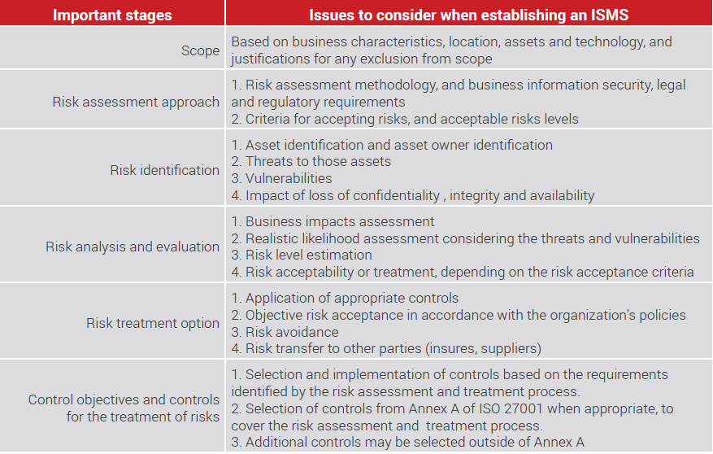
Audit Points for Verifications in Stage 1

Slide 21
Issues in SOA (Stage1 & Stage 2) – Statement of Applicability
Topic | Considerations of points of SOA verifications in Stage 1
Issues within SOA | The controls Justifications for exclusions are correct & justified - Some of the exclusion justification wordings might give understanding that the control is included - Some exclusions may not actually match with Context & Scope i.e. required but claimed – i.e. background verifications (Control A.7.1.1 Screening) is excluded
Issues of SOA in comparison with ISMS Documentation / Implementation | The exclusions in SOA may not be correct - An exclusion claimed in SOA might be actually implemented, like A.10 Cryptographic control may be claimed for exclusion with defined justification but practically it might be actually implemented.
 | The controls Justifications for inclusions are correct & justified - The control actually may not be implemented i.e. A.10 Cryptographic controls but in SOA might be shown as Applicable

Slide 22
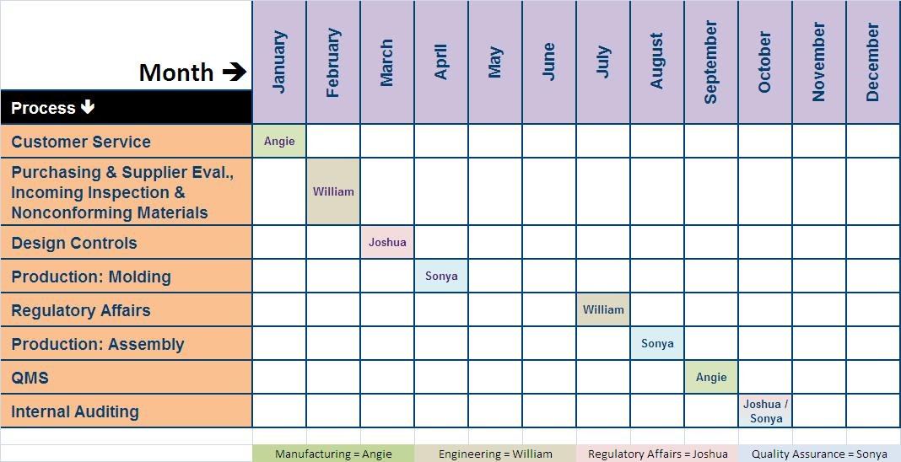
Audit program
An audit program (or programme) is a set of arrangements that are intended to achieve a specific audit purpose within a specific time frame. It includes all of the activities and resources needed to plan, organize, and conduct one or more audits.

Slide 23
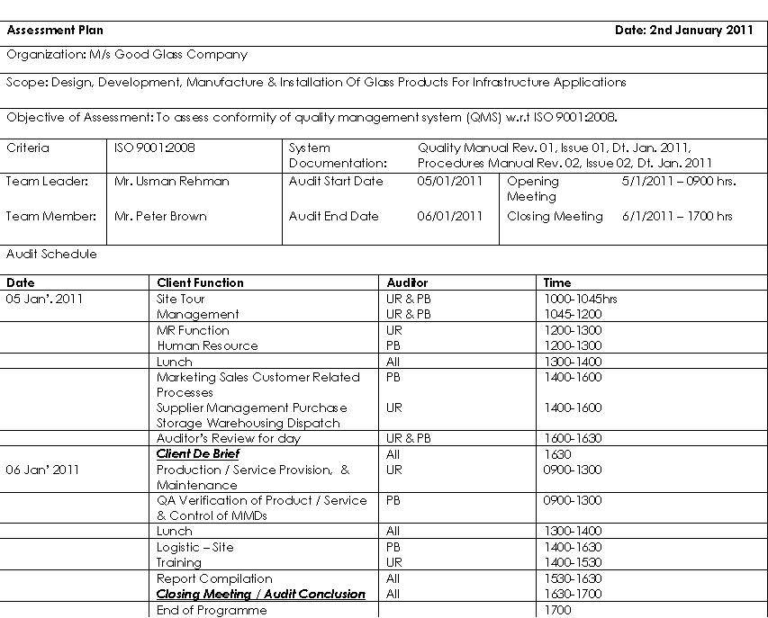
Audit plan
An audit plan specifies how you intend to conduct a particular audit. It describes the activities you intend to carry out in order to achieve your audit objectives.

Slide 24
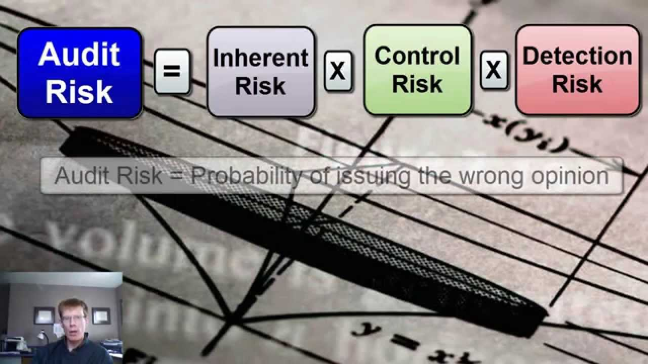
Focus on Audit Scope
&
Objectivity
Auditing Process
Focus on Recording
only the Facts
Terms in Audit Process
AUDIT
AUDIT SCOPE
COMPETENCY
JOINT AUDIT
AUDIT PLAN
AUDIT CLIENT
AUDIT CRITERIA
COMBINED AUDIT
AUDIT PROGRAM
TECHNICAL TEAM
OBJECTIVE EVIDENCE
AUDIT EVIDENCE
AUDIT TEAM
AUDIT CONCLUSIONS
OBSERVER
NONCONFORMITY
AUDITOR
AUDIT FINDINGS
AUDITEE
CONFORMITY
REQUIREMENT
PROCESS
PERFORMANCE
EFFECTIVENESS

Slide 25
Audit Team – Responsibilities & Authorities
Audit Team Leader Responsibilities | Auditor Responsibilities
All the responsibilities of an Auditor , are to be adhered to as mentioned:-→ | Conduct the audit of processes allotted in the Audit Plan, keeping the scope of Audit in mind…as per defined procedures of Audit.
To control the complete Audit as per Audit Plan & to ensure the Time Management & Discipline is maintained during the entire life cycle of Audit. | Control the Audit process in the area allotted and maintain Confidentiality, Integrity & Availability of the information of evidences.
Ensure all the processes of the Audit Scope is covered and decide for any changes based on the audit outcome, if need be, without effecting the scope. | Practicing Good Qualities of the Auditor, keeping in mind the bad Qualities (in mind, - not practice), during Audit.
Guide the audit team in building team work and help in bringing maturity in each Auditor – developing good audit practices in reference to live Audit surroundings. | During the audit process, noting the positive as well as non-conformities (with objective evidences) in the prescribed audit documents of the Audit procedure.
Review the Audit findings of the Auditors, before finalizing the same & that there are sufficient evidences to prove the judgment. | Practicing Good Communication within the Audit Team - exchanging the information and demonstrate good team work.
Final authority in giving judgment on the outcome of the audit. | Reconfirming the audit findings with the auditee or the process owner & report to Audit Team leader, with objective evidences

Slide 26
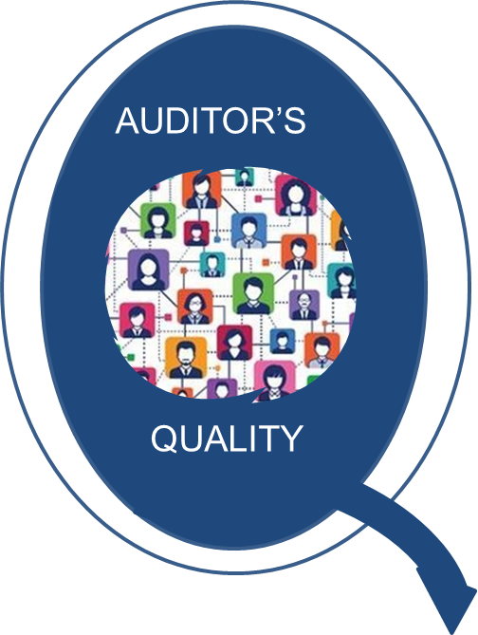
Auditor’s Knowledge
INDUSTRY SECTOR COMPETENCIES
INDUSTRY SECTOR CONTEXT
INDUSTRY SECTOR INTERESTED PARTY REQUIREMENTS
INDUSTRY SECTOR
RISKS
AUDITING PRINCIPLES APPLICATION TO
INDUSTRY SECTOR
INDUSTRY SECTOR REGULATIONS
INDUSTRY SECTOR ACCEPTANCE CRITERIA
INDUSTRY SECTOR INTERPRETAIONS TO AUDIT CRITERIA
INDUSTRY SECTOR PRIORITIES
INDUSTRY SECTOR SYSTEM EFFECTIVNES JUDGEMENT
INDUSTRY SECTOR AUDIT CONCLUSION JUDGEMENT
INDUSTRY SECTOR AUDIT REPORTING

Slide 27
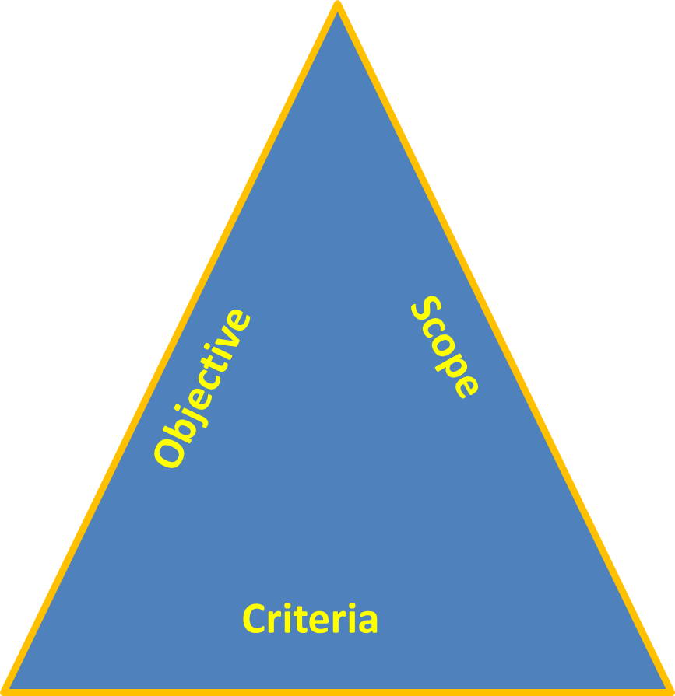
Audit Activities
Audit objectives includes:
Determination of the extent of conformity of ISMS with audit criteria
Evaluation of capability of ISMS to ensure compliance with statutory, regulatory, and contractual requirements of customers
Evaluation of effectiveness of the ISMS to meet its objectives
Identification of areas of improvement
Audit scope describes extent and boundaries of audit:
Physical audit locations of Organization
Activities and processes
Time required for coverage of audit
Audit criteria describes requirements of the Management Systems for audit:
ISO 27001:2013 standard
Customer requirements
Legal requirements pertaining to product

Slide 28
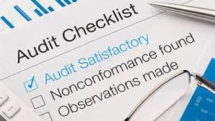
Audit Activities – audit checklist
1. Helps auditor in logical sequence of the process
2. Ensures that auditor does not allow any point to be missed out
3. Gives guidance to auditor to focus on the scope of the audit
4. Checklists may lead to rigid adherence to pre-planned Questions
Audit checklist - benefits
Keep audit scope and objectives clear
Provide evidence of audit planning
Maintain audit pace and continuity
Reduce auditor bias
Reduce workload during audit
Provide space for auditor notes
Identify expected evidence

Slide 29

Drawback of Audit Checklists – if not drafted in line with Audit Objective (at times)
Checklists tend to lose value if they are:
Tick lists
Questionnaires
Checklists may lead to rigid adherence to pre-planned questions
Audit Activities – Audit Checklist - Example
CONTENTS OF AUDIT CHECKLISTS
Pre-Audit Checkpoint Preparation |  |  | During Audit
Requirement | Source | Evidence | Notes | Audit Conclusion [ Complying / Not Complying ]
ISO 27001 Clause # or other requirement | What to “look at” | What to “look for”: Process/Activity Audited: | Notes of how to follow up/what to follow up on | Concluding the effectiveness of system is good or any concerns – NC (Non-compliance

Slide 30
END

